Slide 1
Xamarin Android
User Interface & Platform Features
Kishore Kolla

Slide 2
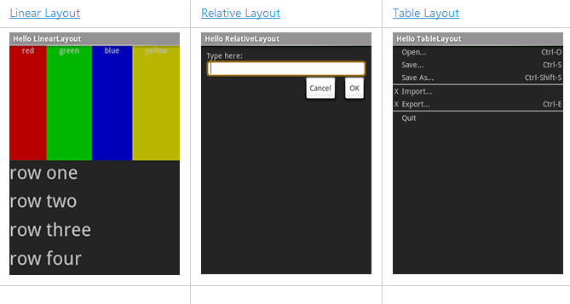
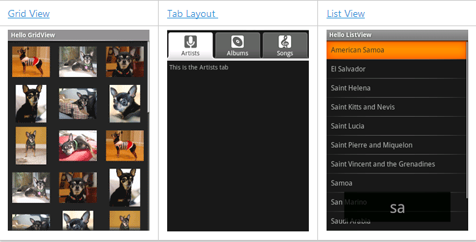
Layouts

Slide 3
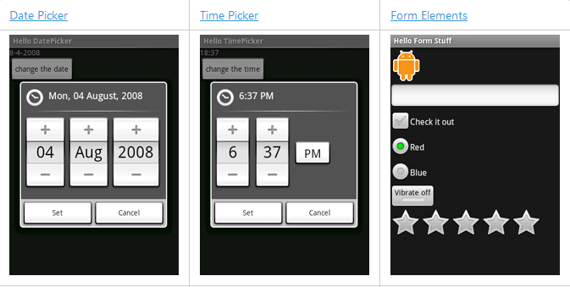
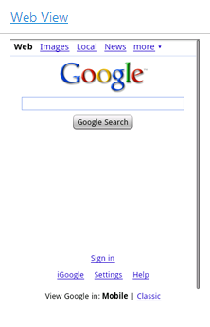
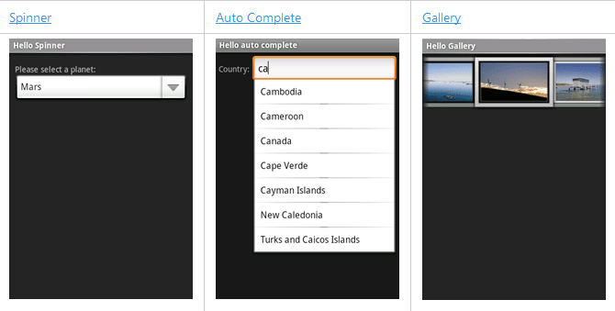
Widgets & Other Views

Slide 4
Splash Screen

Slide 6
Platform Features
Key Components of the Android Platform
Fragments
Maps and Location
Android Speech

Slide 7
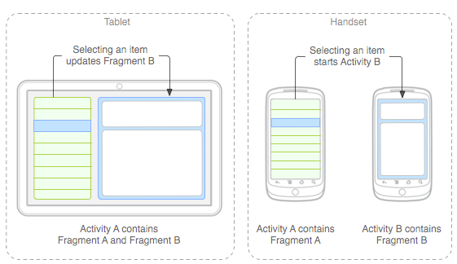
Fragments
Introduced from Android 3.0 (API level 11).
Support more flexible designs for many different screen sizes on phones and tablets.
Bundles up pieces of UI controls into one small activity so that deveolper can place them any Activity as re-usable control.

Slide 8
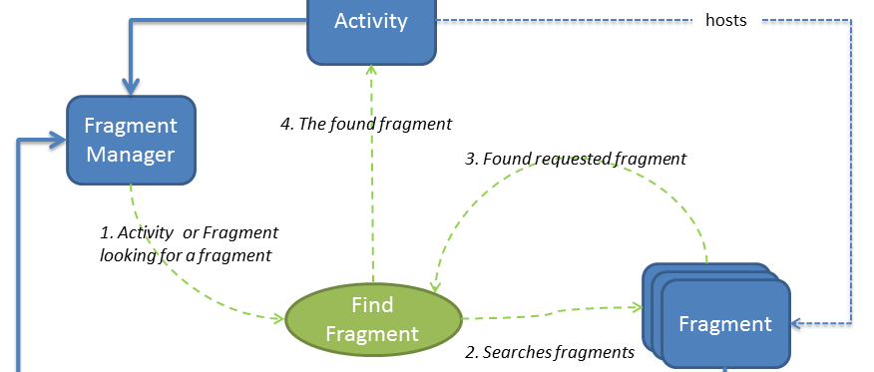
FragmentManager
FragmentManager class helps in playing with Fragment in an Activity.
Each Activity has its own instance of a FragmentManager for adding, deleting, and finding hosted Fragments.

Slide 9
Maps and Location
Android provides access to various location technologies such as cell tower location, Wi-Fi, and GPS.
The details of each location technology are abstracted through location providers.
Example : https://developer.xamarin.com/samples/monodroid/Location/
https://developer.xamarin.com/samples/monodroid/MapsAndLocationDemo_v3/

Slide 10
Android Speech

